Slide 1
INFT 1105
1 UP 25000
2 UP 003200
Introduction
To Databases
Christopher Alexander
Winter 2024
CREDITS

Slide 2
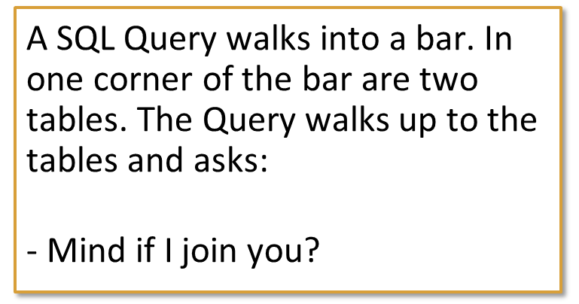

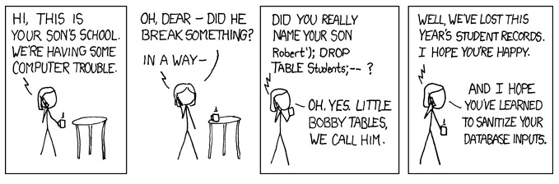
Database’s
Do you get these?
Don’t be discouraged if you don’t.
That’s what this course is about.

Slide 3
Why are we using this software?
SQL Server 2019 Developer Edition
  Hosts the database on your laptop
SQL Server Management Studio (SSMS)
  This is what we use to talk to the database
  SQL Data Definition Language (DDL)
  for administration of Tables, Indexes, Views
  SQL Data Manipulation Language (DML)
  for basic commands and functions
  to manipulate data in a database
Visio
  Diagramming tool

Slide 4

Learning Objectives
After this presentation, you will be able to:
  Define the difference between data and information
  Describe what a database is, various types, and why they are valuable assets for decision making
  Explain the importance of database design
  See how modern databases evolved from file systems
  Understand flaws in file system data management
  Outline the main components of the database system
  Describe the main functions of a database management system (DBMS)

Slide 5
Why Databases?
Characteristics of data in today’s world
  Ubiquitous (i.e., abundant, global, and everywhere)
  Pervasive (i.e., unescapable, prevalent, and persistent)
Databases make data persistent and shareable in a secure way
  Specialized structures that allow computer-based systems to store, manage, and retrieve data very quickly

Slide 6
Data versus Information
Data consists of raw facts
  Not yet processed to reveal meaning to the end user
  Building blocks of information
Information results from processing raw data to reveal meaning
  Requires context
  Bedrock of knowledge
  Should be accurate, relevant, and timely

Slide 7
Introducing the Database
Shared, integrated computer structure that stores data
  End-user data: raw facts of interest to end user
  Metadata: data about data, through which the end-user data is integrated and managed
    Describes data characteristics and relationships
Database management system (DBMS)
  Collection of programs
  Manages the database structure
  Controls access to data stored in the database

Slide 8
Role and Advantages of the DBMS (1 of 2)
Database management system (DBMS): intermediary between the user and the database
  Enables data to be shared
  Presents the end user with an integrated view of data
  Provides more efficient and effective data management
  Improves sharing, security, integration, access, decision-making, productivity, etc.

Slide 9
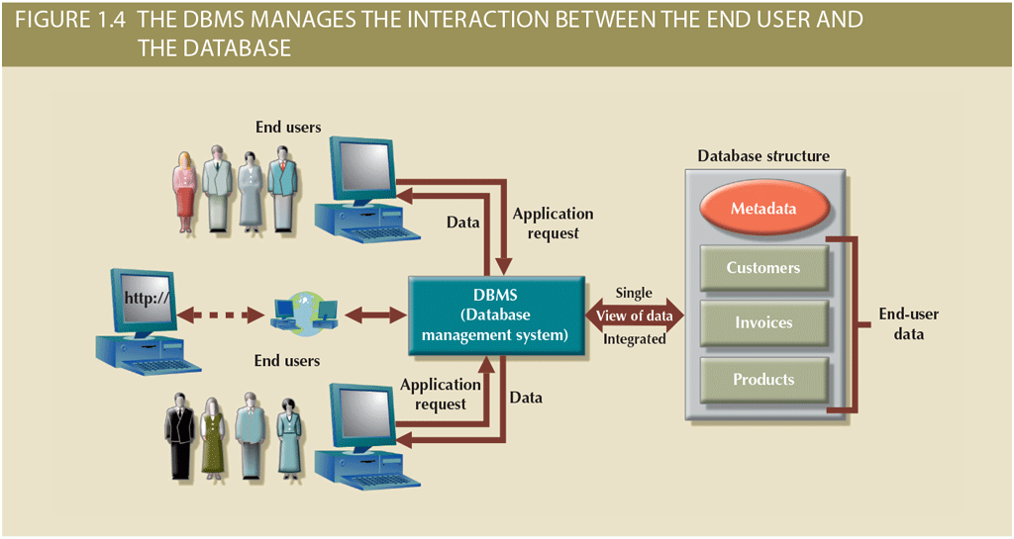
Role and Advantages of the DBMS (2 of 2)

Slide 10
Types of Databases (1 of 5)
Single-user database: supports one user at a time
  Desktop database: single-user database on a personal computer
Multiuser database: supports multiple users at the same time
  Workgroup databases: supports a small number of users or a specific department
  Enterprise database: supports many users across many departments

Slide 11
Types of Databases (2 of 5)
Classification by location
  Centralized database: data located at a single site
  Distributed database: data distributed across different sites
  Cloud database: created and maintained using cloud data services that provide defined performance measures for the database

Slide 12
Types of Databases (3 of 5)
Classification by data type
  General-purpose database: contains a wide variety of data used in multiple disciplines
  Discipline-specific database: contains data focused on specific subject areas
  Operational database: designed to support a company’s day-to-day operations

Slide 13
Types of Databases (4 of 5)
Analytical database: stores historical data and business metrics used exclusively for tactical or strategic decision making
  Data warehouse: stores data in a format optimized for decision support
  Online analytical processing (OLAP): tools for retrieving, processing, and modeling data from the data warehouse
  Business intelligence: captures and processes business data to generate information that support decision making

Slide 14
Types of Databases (5 of 5)
Databases can be classified to reflect the degree to which the data is structured
  Unstructured data exists in its original (raw) state
  Structured data results from formatting
    Structure is applied based on type of processing to be performed
  Semistructured data: processed to some extent
Extensible Markup Language (XML)
  Represents data elements in textual format

Slide 15
Why Database Design Is Important
Focuses on design of database structure that will be used to store and manage end-user data
  Well-designed database: facilitates data management and generates accurate and valuable information
  Poorly designed database: causes difficult-to-trace errors that may lead to poor decision making

Slide 16
Evolution of File System Data Processing (1 of 3)
Manual file systems
  Accomplished through a system of file folders and filing cabinets
Computerized file systems
  Data processing (DP) specialist created a computer-based system to track data and produce required reports
File system redux: modern end-user productivity tools
  Includes spreadsheet programs such as Microsoft Excel

Slide 17
Evolution of File System Data Processing (2 of 3)
Table 1.2 | Basic File Terminology
TERM | DEFINITION
Data | Raw facts, such as a telephone number, a birth date, a customer name, and a year-to-date (YTD) sales value. Data has little meaning unless it has been organized in some logical manner.
Field | A character or group of characters (alphabetic or numeric) that has a specific meaning. A field is used to define and store data.
Record | A logically connected set of one or more fields that describes a person, place, or thing. For example, the fields that constitute a record for a customer might consist of the customer’s name, address, phone number, date of birth, credit limit, and unpaid balance.
File | A collection of related records. For example, a file might contain data about the students currently enrolled at Gigantic University.

Slide 18
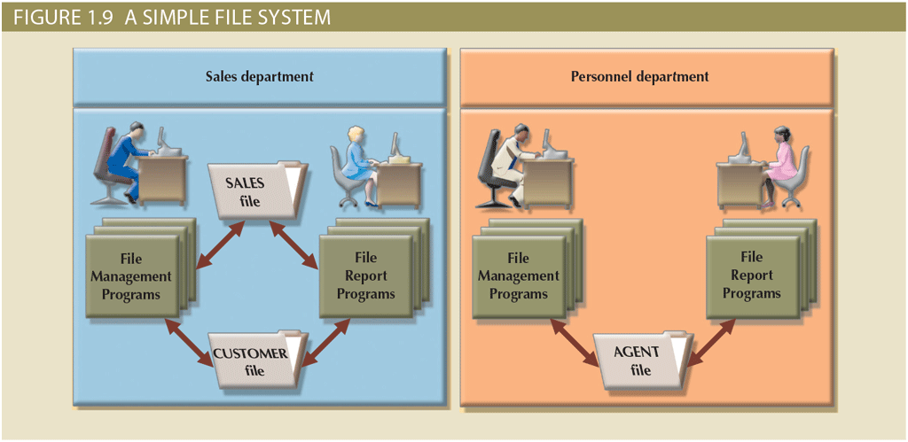
Evolution of File System Data Processing (3 of 3)

Slide 19
Problems with File System Data Processing
Problems with file systems challenge the types of information that can be created from data as well as information accuracy
  Lengthy development times
  Difficulty of getting quick answers
  Complex system administration
  Lack of security and limited data sharing
  Extensive programming

Slide 20
Structural and Data Dependence (1 of 2)
Structural dependence
  Access to a file is dependent on its own structure
  All file system programs are modified to conform to a new file structure
Structural independence
  File structure is changed without affecting the application’s ability to access the data

Slide 21
Structural and Data Dependence (2 of 2)
Data dependence
  Data access changes when data storage characteristics change
Data independence
  Data storage characteristics are changed without affecting the program’s ability to access the data
Practical significance of data dependence is the difference between logical and physical format

Slide 22
Data Redundancy (1 of 2)
Unnecessarily storing the same data at different places
  Islands of information (i.e., scattered data locations)
  Increases the probability of having different versions of the same data

Slide 23
Data Redundancy (2 of 2)
Possible results of uncontrolled data redundancy
  Poor data security
  Data inconsistency
  Data-entry errors
  Data integrity problems

Slide 24
Data Anomalies
Develop when not all of the required changes in the redundant data are made successfully
  Update anomalies
  Insertion anomalies
  Deletion anomalies

Slide 25
Database Systems (1 of 2)
Logically related data stored in a single logical data repository
  Physically distributed among multiple storage facilities
  DBMS eliminates most of file system’s data inconsistency, data anomaly, data dependence, and structural dependence problems
Current generation DBMS software
    Stores data structures, relationships between structures, and access paths
    Defines, stores, and manages all access paths and components

Slide 26
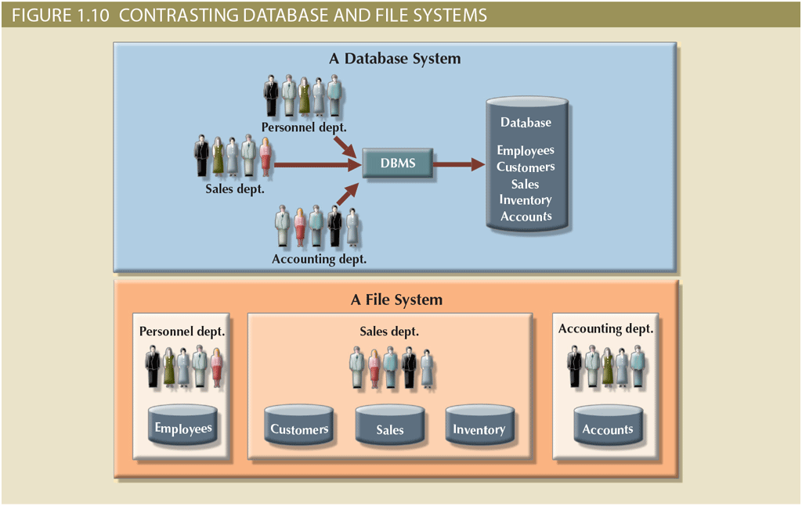
Database Systems (2 of 2)

Slide 27
The Database System Environment (1 of 2)
Database system: organization of components that define and regulate the collection, storage, management, and use of data within a database environment
  Hardware
  Software
  People
  Procedures
  Data

Slide 28
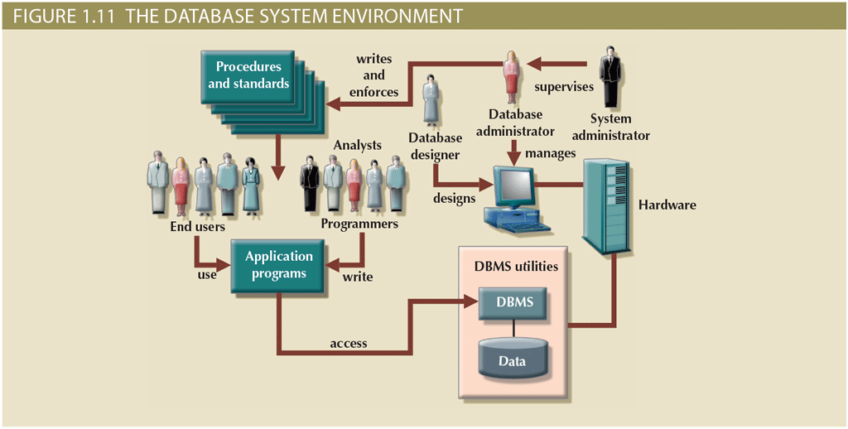
The Database System Environment (2 of 2)

Slide 29
DBMS Functions (1 of 3)
Data dictionary management
  Data dictionary: stores definitions of data elements and their relationships
Data storage management
  Performance tuning ensures efficient performance
Data transformation and presentation
  Data is formatted to conform to logical expectations
Security management
  Enforces user security and data privacy

Slide 30
DBMS Functions (2 of 3)
Multiuser access control
  Sophisticated algorithms ensure that multiple users can access the database concurrently without compromising its integrity
Backup and recovery management
  Enables recovery of the database after a failure
Data integrity management
  Minimizes redundancy and maximizes consistency

Slide 31
DBMS Functions (3 of 3)
Database access languages and application programming interfaces
  Query language: lets the user specify what must be done without having to specify how
  Structured Query Language (SQL): de facto query language and data access standard supported by the majority of DBMS vendors
Database communication interfaces
  Accept end-user requests via multiple, different network environments

Slide 32
Managing the Database System: A Shift in Focus
Disadvantages of database systems
  Increased costs
  Management complexity
  Maintaining currency
  Vendor dependence
  Frequent upgrade/replacement cycles

Slide 33
Preparing for Your Database Professional Career
TABLE 1.3 | DATABASE CAREER OPPORTUNITIES
JOB TITLE | DESCRIPTION | SAMPLE SKILLS REQUIRED
Database Developer | Create and maintain database-based applications | Programming, database fundamentals, SQL
Database Designer | Design and maintain databases | Systems design, database design, SQL
Database Administrator | Manage and maintain DBMS and databases | Database fundamentals, SQL, vendor courses
Database Analyst | Develop databases for decision support reporting | QL, query optimization, data warehouses
Database Architect | Design and implementation of database environments (conceptual, logical, and physical) | DBMS fundamentals, data modeling, SQL, hardware knowledge, etc.
Database Consultant | Help companies leverage database technologies to improve business processes and achieve specific goals | Database fundamentals, data modeling, database design, SQL, DBMS, hardware, vendor-specific technologies, etc.
Database Security Officer | Implement security policies for data administration | DBMS fundamentals, database administration, SQL, data security technologies, etc.
Cloud Computing Data Architect | Design and implement the infrastructure for next-generation cloud database systems | Internet technologies, cloud storage technologies, data security, performance tuning, large databases, etc.
Data Scientist | Analyze large amounts of varied data to generate insights, relationships, and predictable behaviors | Data analysis, statistics, advanced mathematics, SQL, programming, data mining, machine learning, data visualization

Slide 34
Summary
Data consists of raw facts and is usually stored in a database
  Database design defines the database structure
    Can be classified according to the number of users, location, as well as data usage and structure
  Databases evolved from manual and computerized file systems
    There are some limitations of file system data management
    DBMSs were developed to address the file system’s inherent weaknesses

